Slide 1
Journey Presentation WEEK 7
Anisha Gupta (Batch- 4)

Slide 2
CUSTOM TRAINING

Slide 3

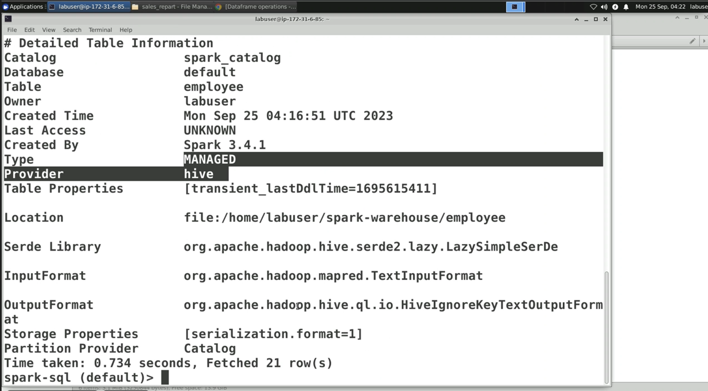
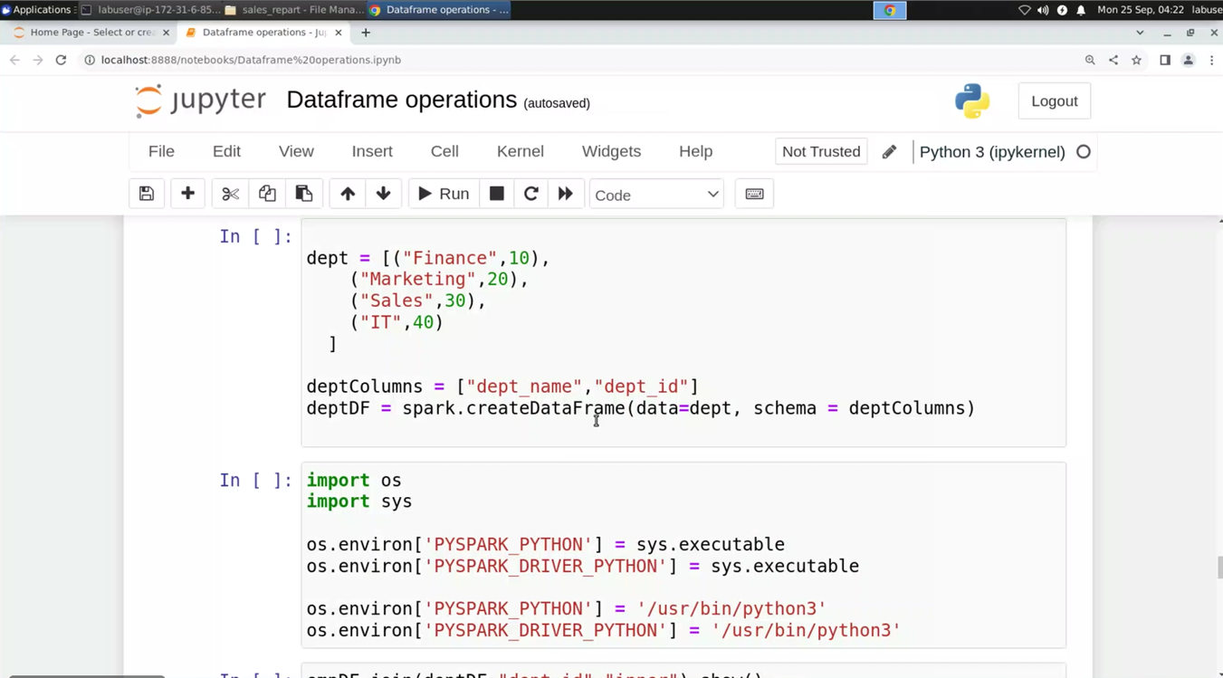
DAY 18: 25-09-2023

Slide 4
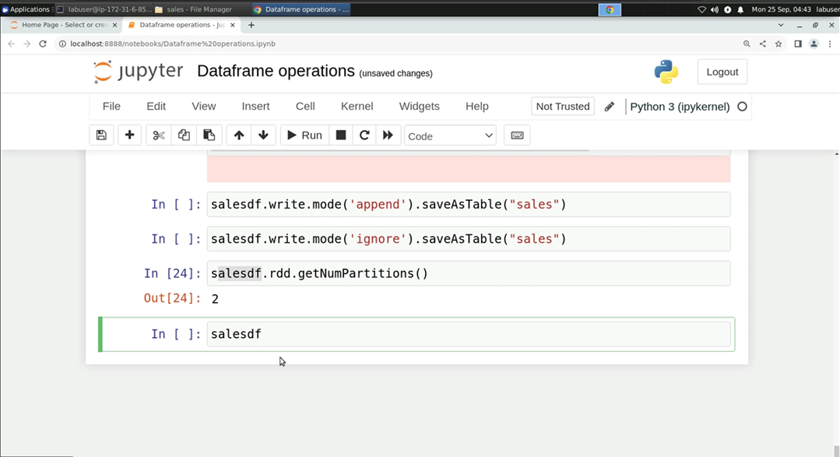
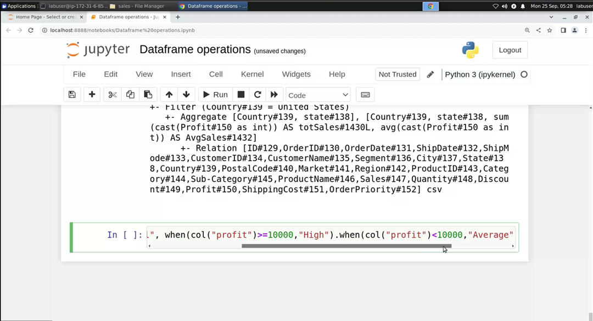
DAY 18: 25-09-2023

Slide 5
DAY 19: 26-09-2023
Databricks:
Cloud Platform – AWS, Azure and GCP
Compute layer → Clusters
Types of clusters:
All process compute.
Job Compute
SQL Warehouse
Pool Shared
Data stored in DBFS (Database File System), written from /root
Or data can be uploaded from data partners
Mounting process to connect external source to DBFS – uses access key, SAS token - service principle

Slide 6
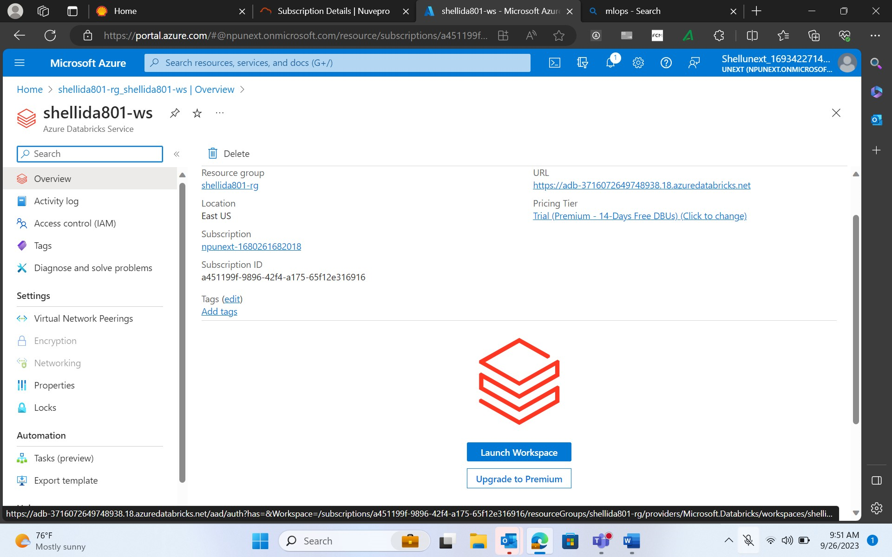
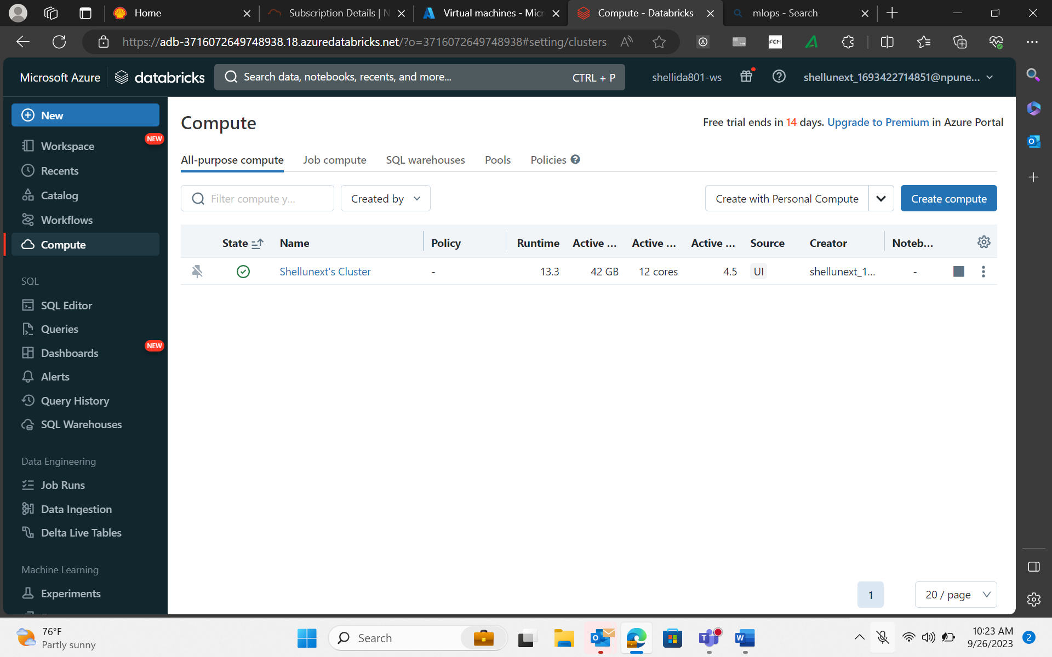
Created Databricks Service on my Azure Portal
Databricks Cluster

Slide 7
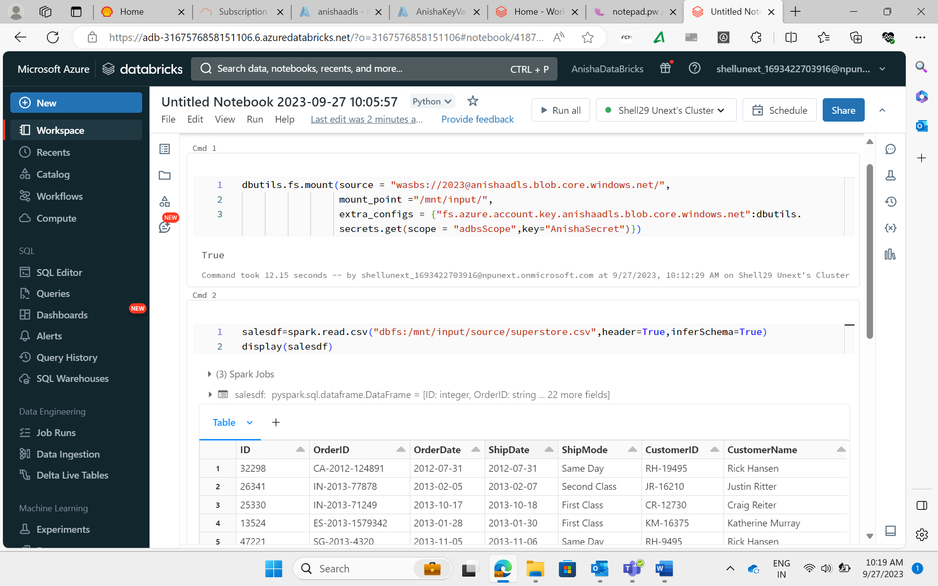
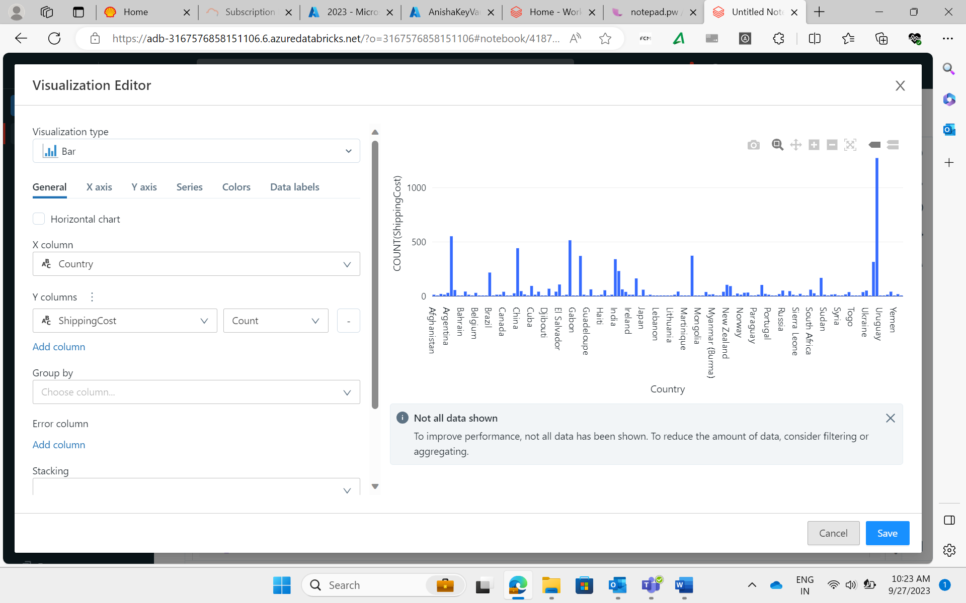
Mounting data into Databricks and reading the csv file
Data Visualization using Databricks

Slide 8
DAY 20: 27-09-2023
Databricks Continuation
Dataframe reader Modes: Permissive, dropmalformed, failfast
Dataframe Writer Modes: savemodes → ignore, append, overwrite
Output Modes: Complete, append, update
Explored Delta Table and its properties
Optimization Techniques: partitionBy, bucketBy
Accessed data in databricks using AzureSQL
Widgets

Slide 9
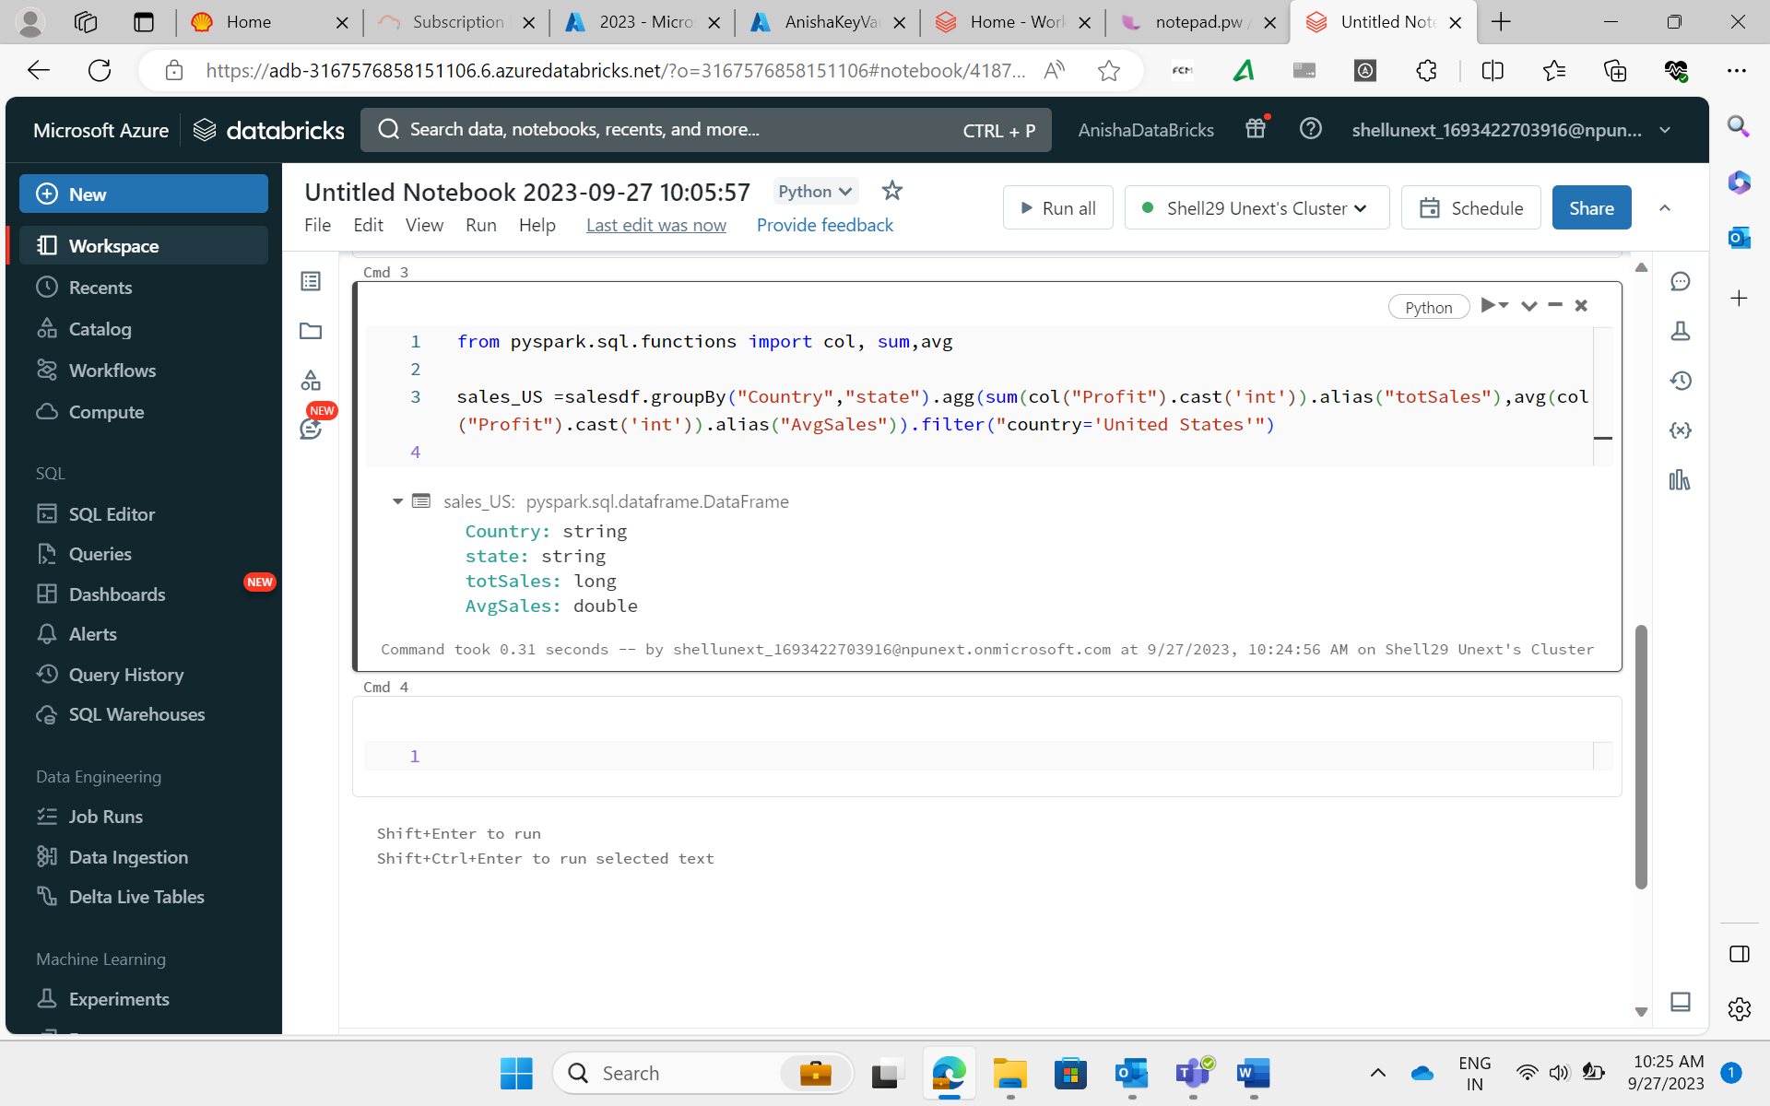
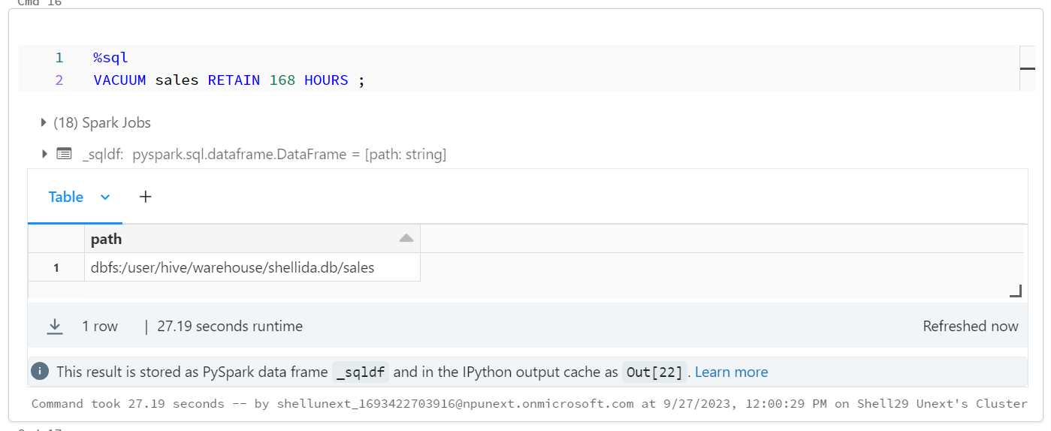
Aggregation and Filter functions on sales data
Vaccuum feature of Delta Table: removes unused files from table directories

Slide 10
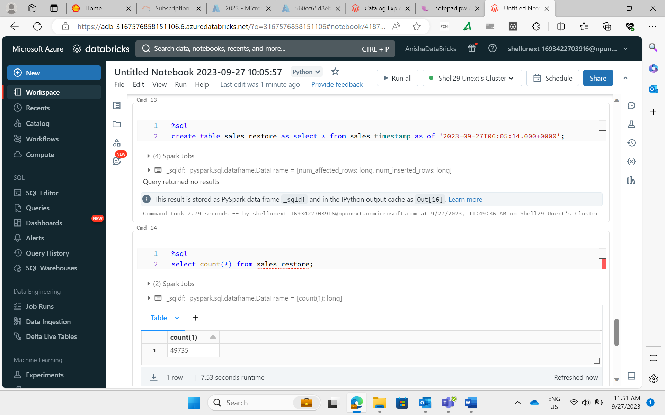
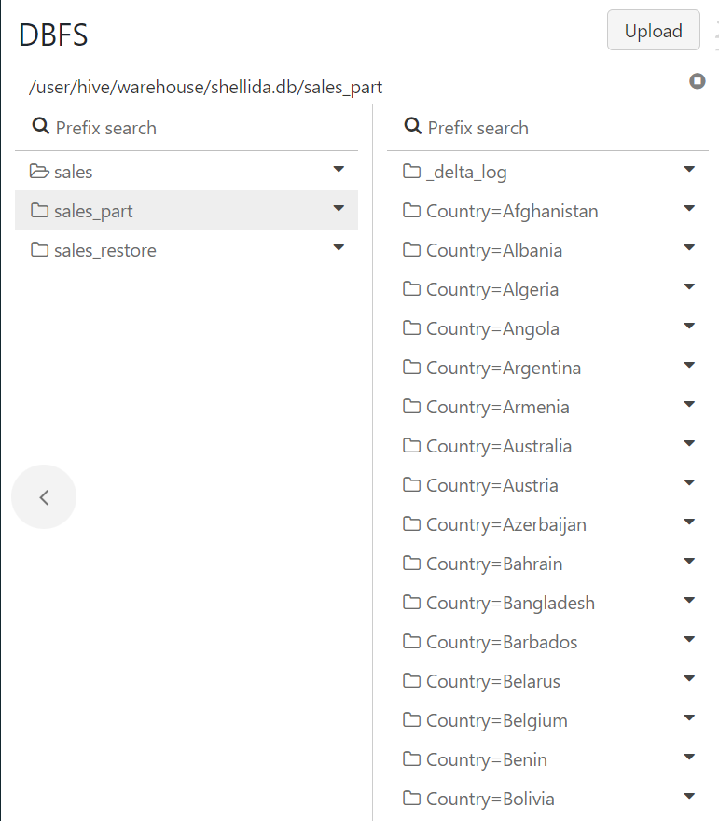
Explored Time Travel feature of Delta Tables
Result of partitionBy optimization technique

Slide 11
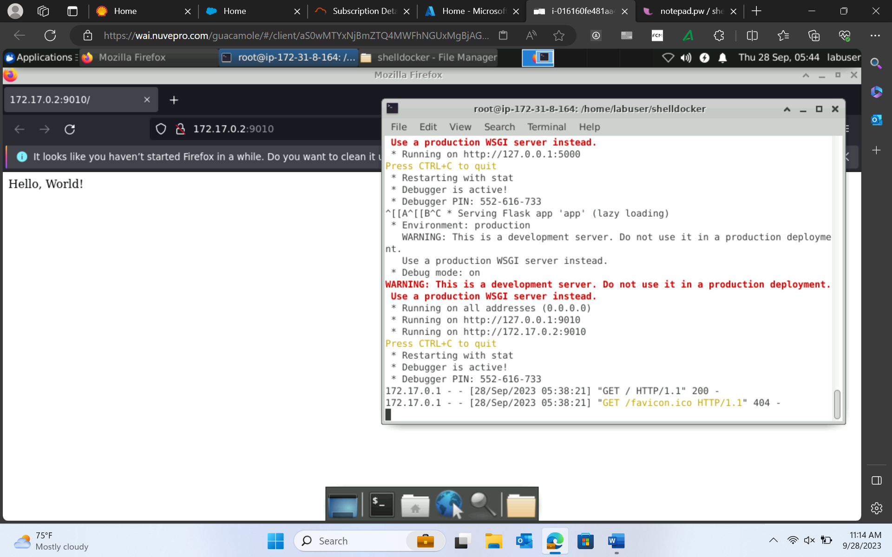
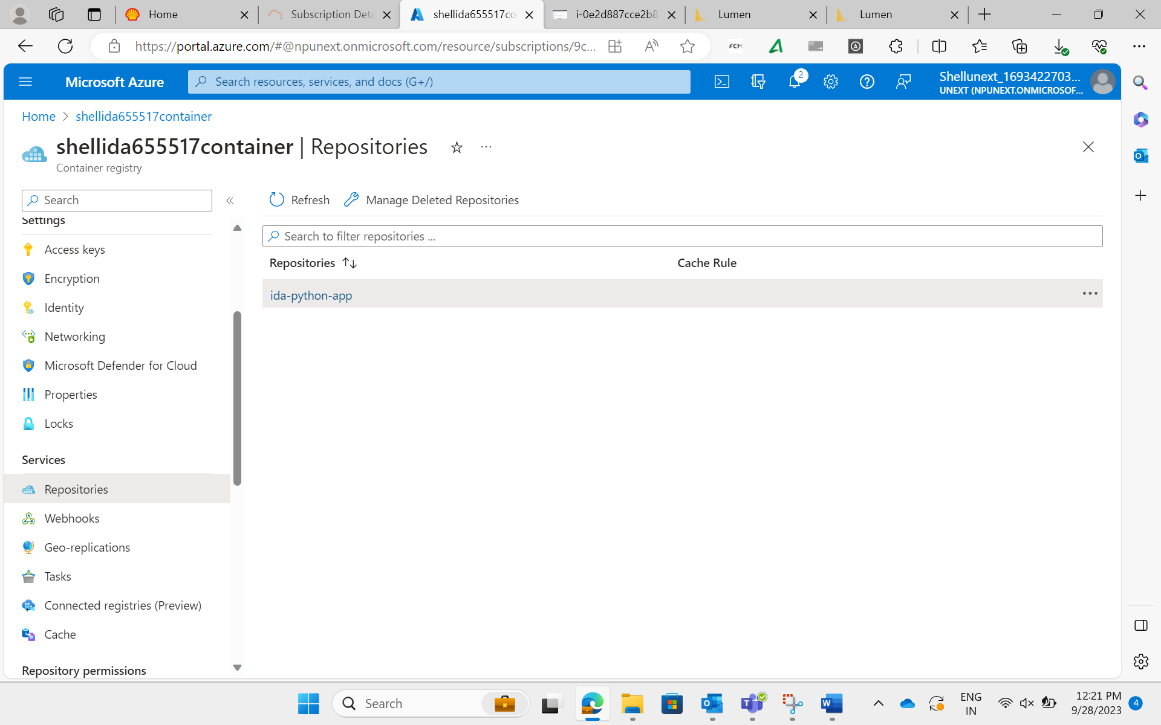
DAY 21: 28-09-2023

Slide 12
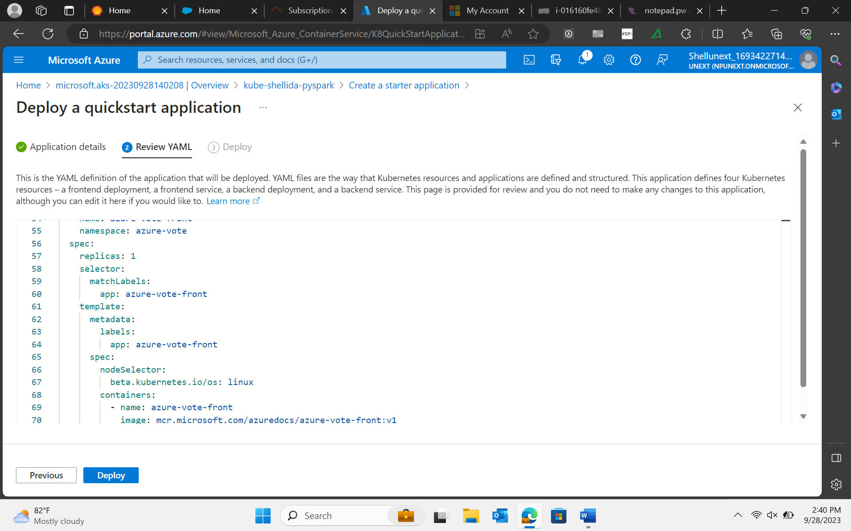
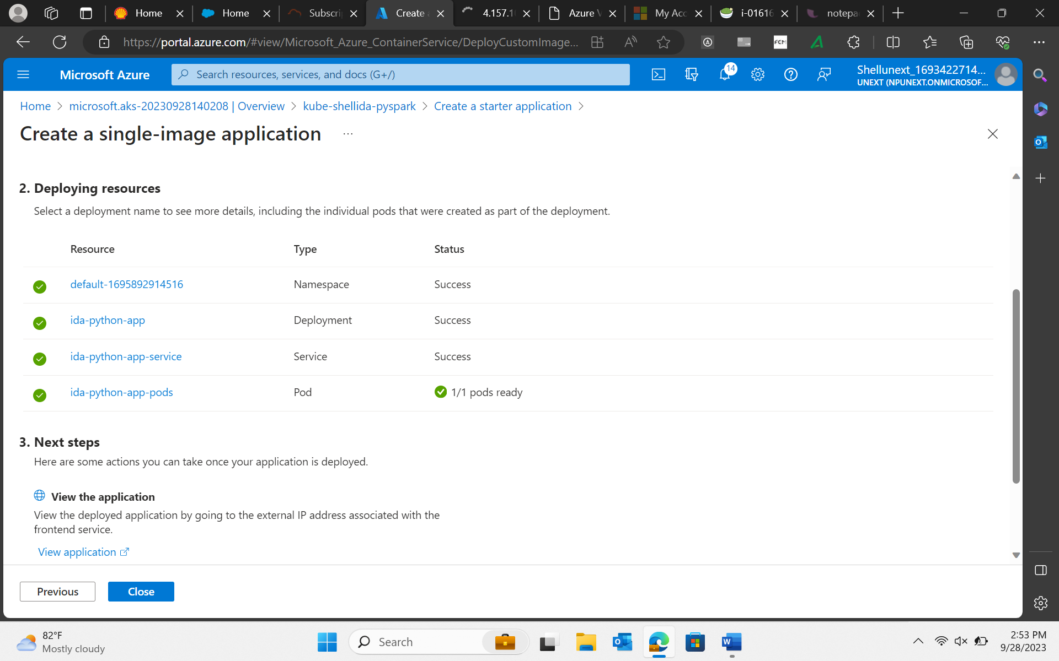
DAY 21: 28-09-2023

Slide 13
DAY 22: 29-09-2023
Azure Deployment/ Devops
Basics of Cloud Computing
To do devops, we need:
Github
Azure Devops organization
Managed host C1/CD
Boards: work items- epics, features, user stories, tasks

Slide 14
